Slide 1
CYGNUS VALUENET Business Plan
Kamal Kant Vashisth, PhD

Slide 2
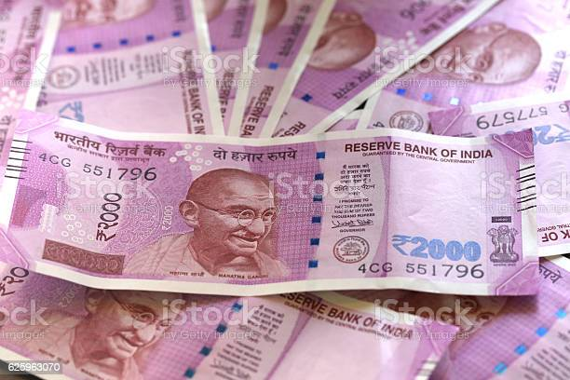
Types of Income
Retail Profit- 20%
Jump Start Bonus- 10%
DR Income Incentive- 5%
Loyalty Bonus- 15-25%
Performance Bonus- Max. 25%
Leadership Bonus- Max. 7%
Training & Traveling Fund- 4%
Vehicle Fund- 3%
House Fund- 2%
Rank Achievement Awards

Slide 3
Simple Ones
Retail profit- 20%
Loyalty 1- 1000 BV/ Month- 4 Months- Rs 1500/- (DP) Product Free
Loyalty 2- 2500 BV/ Month- 4 Months- Rs 5000/- (DP) Product Free
Jump Start Bonus- 10% (Self- L2, Group- L2 DRs in any of 1st three months, min. 2, max 4 legs)
Proposer Income Incentive- 5% (of DR income)

Slide 4
Performance Bonus- Min. 2500 BV/ Group; 2500 BV= 1 Point; Matching with Power Leg
Silver: Matching 2 Groups- 21%- Max. 150 Points (Profit Leg) (Min. 30000 BV- QSILVER)
Gold: 3rd group- 23%- Max. 170 Points (Freedom Leg) (From pool of only 3rd leg BV) (30K BV- QGOLD)
Star: 4th group- 25%- Max. 200 Points
(Success Leg) (30BV- QSTAR)
Same as 4th group for all further groups

Slide 5
Training & Traveling Fund- 4%
Matching Power Leg Vs. ROG
12500 BV: 12500 BV= 1 Point
Max. 25K+25K

Slide 6
Vehicle Fund- 3% (3 Months consecutive QGold qualification) ( To be kept by company & released on buying vehicle)
Matching Power leg Vs. ROG
25K BV: 25K BV= 1 Point
Max. 75K

Slide 7
House fund- 2% (3 Months consecutive Star qualification) ( to be kept by company & released on buying a house)
Matching Power Leg Vs. ROG
50K BV: 50K BV= 1 Point
Max. 1 L

Slide 8
Leadership Bonus- Min. 1L BV/ Group; 1L BV= 1 Point; Matching with Power Leg
Platinum: Matching 2 Groups- 5%- Max 5L
Topaz: 3rd group- 6%- 7L max.
Ruby: 4th group- 7%- 10L max.
Same as 4th group for all further groups.

Slide 9
One Time Rank Achievement Awards (OTRAA)
CYGNUS Emerald- Matching Power leg Vs. ROG
10L BV: 10L BV= Rs. 7.5L
3 out of any 6 months, 2 months consecutive
CYGNUS Crown- Matching Power leg Vs. ROG
50L BV: 50L BV= Rs. 50L
3 out of any 6 months, 2 months consecutive
CYGNUS Diamond- Matching Power leg Vs. ROG
25L BV: 25L BV= Rs. 22L
3 out of any 6 months, 2 months consecutive
CYGNUS Crown Ambassador- Matching Power leg Vs. ROG
90L BV: 90L BV= Rs. 1 Cr
3 out of any 6 months, 2 months consecutive

Slide 10
Thanks

